Slide 1
Outcomes of loan Approval prediction model

Slide 2
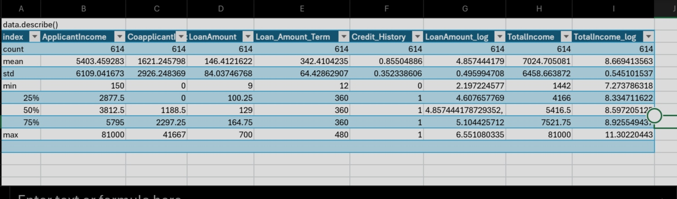
Descriptive analysis

Slide 3
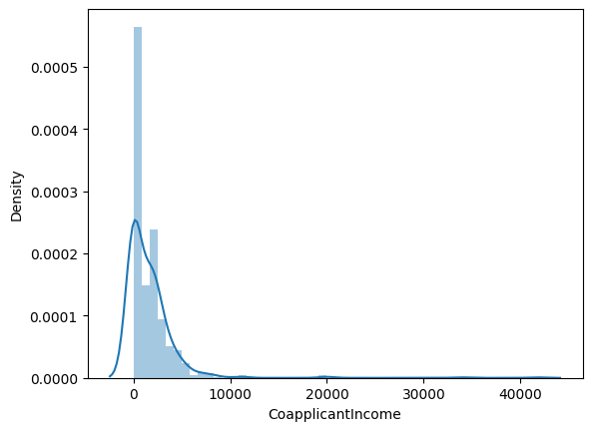
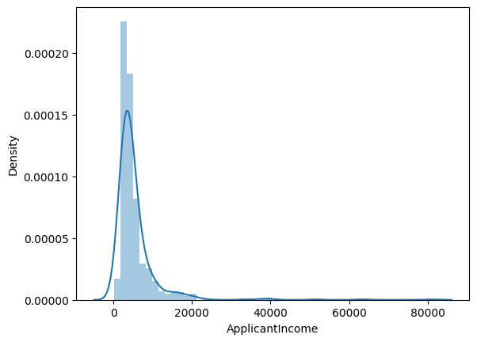

Slide 4
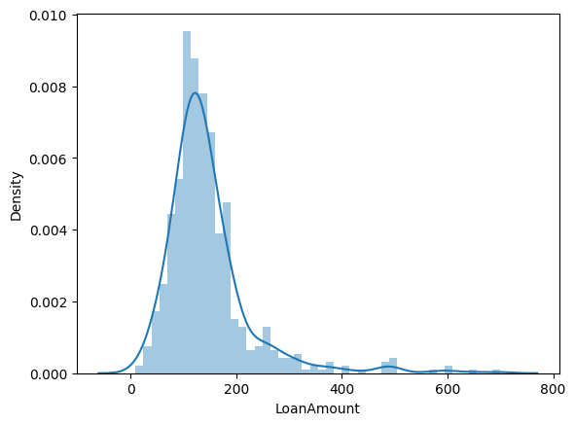
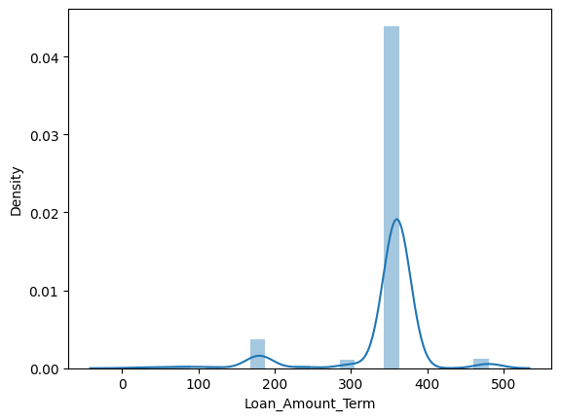
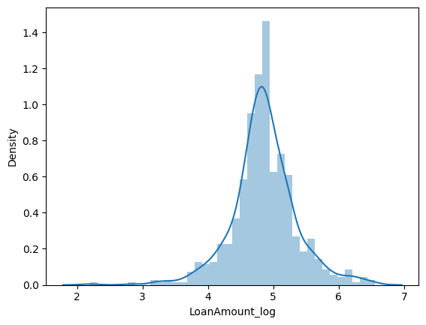

Slide 6
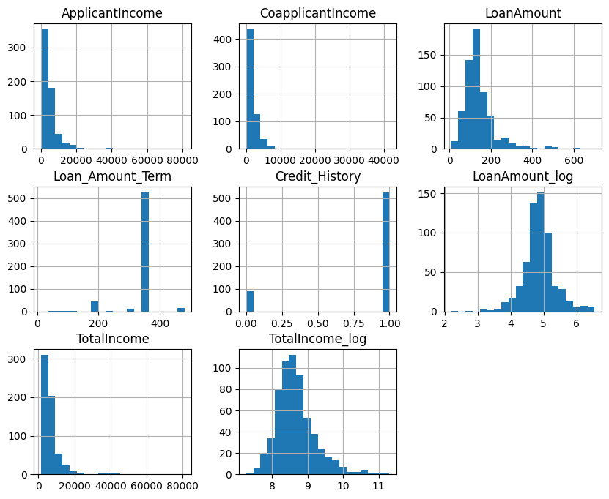

Slide 7
Model specifications
Support Vendor Machine accuracy: 0.68
Logistic Regression accuracy: 0.80
Random Forest accuracy: 0.31
Decision Tree accuracy: 0.40

